Slide 1
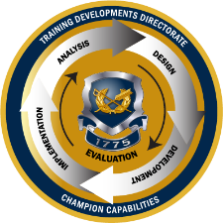

TJAGLCS Training Package
Pretrial Restraint
December 2024

Slide 2
The information provided throughout this training aid does not, and is not intended to, constitute legal advice; instead, all information, laws, statues, content, and materials for this training aid are for general informational purposes only. This training aid may not constitute the most up-to-date legal or other relevant legal information. Judge Advocates need to conduct their own due diligence through independent further legal research on any specific legal issue contained in this training package. No reader, user, or trainee of this product should act or refrain from acting based on information from this training aid without first seeking legal advice from an attorney in the relevant jurisdiction.

Slide 3
Pretrial Restraint

Slide 4
References
UCMJ, Articles 6b.,7, 9, 10, 13
R.C.M. 302, 304, 305
Criminal Law Online Deskbook, Chapter 7
AR 27-10 (20 April 2024)
Notes:
Art 7 = Apprehension
Article 9 = Restraint
Article 10 = arrest
Article 13 = prohibition on pre-trial punishment
RCM 302 = apprehension
RCM 304 = PTR
RCM 305 = PTC

Slide 5
Learning Objectives
Understand purpose and procedural requirements for pretrial confinement and restraint.
Recognize impacts of PTR on an accused, the command, victims, and counsel.
Analyze facts and accurately advie on potential restrictions taking into consideration legal consequences of the imposition of PTC or PTR.

Slide 6




APPEAL
Pretrial Restraint Spans Entire MJ Process
ENTRY OF JUDGMENT/CONVENING AUTHORITY ACTION
Pretrial restraint can affect case disposition.
MOTIONS
MERITS
SENTENCING
POST-TRIAL
GENERAL OR SPECIAL COURT-MARTIAL
Allegation
Most likely arise here
ARRAIGNMENT
SERVICE ON THE ACCUSED
REFERRAL
SUMMARY
COURT-MARTIAL
GCMCA
Higher HQs
SPCMCA
DIVISION
SCMCA
ART 32
INVESTIGATION
BRIGADE
BATTALION
PREFERRAL
COMPANY
Office of the Special Trial Counsel
ARTICLE 15
ADMINISTRATIVE ACTION
ADVERSE PERSONNEL ACTION
DISMISS CHARGES
NO ACTION
ALTERNATIVE DISPOSITION
Notes:
Put this block into context: will cover 3 topics in 3 hours…pretrial restraint and confinement, speedy trial, sentence credit
Topics seem random but they all tend to flow into each other
Span from the initial investigation of the crime, all the way to sentencing
PTR/PTC will most likely come up during the period between the crime and preferral, in the investigation phase…could also come up later
Speedy trial considers whether they GOV brought the Accused to trial fast enough and runs from the triggering event (generally PTC or preferral) all the way to trial (generally arraignment)
Sentence credit applies at the sentencing phase and allows the MJ to give the Accused credit for all the things that happened before
Speedy trial significance: speedy trial is something TC and DC need to think about in EVERY CM because one or more sources will always apply, but should rarely be an issue if TC does their job right
Not uncommon for cases to be dismissed without prejudice (and less often with prejudice) due to speedy trial clock violations
Very embarrassing for TC if case is dismissed (command, SJA, victims will all be irate)
Very lucrative opportunity for DC to better situate their client with a dismissal

Slide 7
Pretrial Restraint: Defined
“Is moral or physical restraint on a person’s liberty which is imposed before and during disposition of offenses” R.C.M. 304(a).
May be ordered orally or in writing. (best practice is to do it in writing)
Restraint of persons subject to the code.
May not be used as punishment!

Slide 8
Important PTR Considerations
Restriction on liberty is serious
  Can carry case dispositive remedies
  Loss of Confidence (Command and Victims)
  Wasted Resources
Effects on the Accused:
  Is in jail
  Is restricted
  Is flagged
  Increased Stress
  Has career on hold

Slide 9
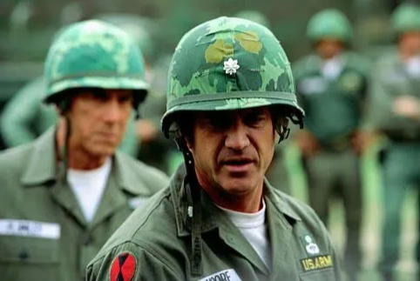
Pretrial Restraint: Authority, R.C.M. 304(b)
Who Can Order PTR?
Commanders can, on any member of the command.
A commissioned officer can, on any enlisted Soldier.
A commander can delegate PTR authority to an NCO or warrant officer, BUT only over enlisted Soldiers.
A superior authority (commander) can withhold!
PRACTICE TIP: Will always be the commander who orders PTR!

Slide 10
Pretrial Restraint Requirements
Practice Tips
Legal Standard is PROBABLE CAUSE
R.C.M. 304 (c)
Dates and type of PTR must be noted on Charge Sheet
NOTICE TO ACCUSED:
  limits of PTR, and
  reasons for PTR
Narrowly tailor restraint to the circumstances.
Provide candid advice to the commander about logistic and legal repercussions of PTR.
Defined as a reasonable belief that:
Offense committed;
Soldier did it; and
Restraint required by the circumstances
  to ensure presence of accused, or
  prevent foreseeable future serious misconduct

Slide 11
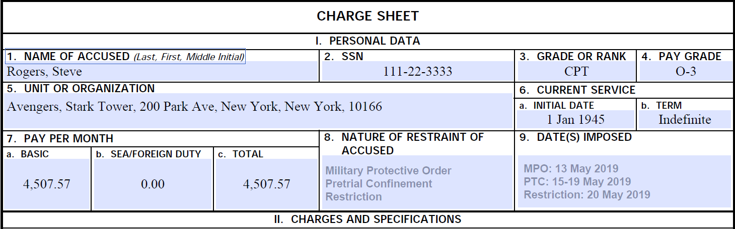

Slide 12
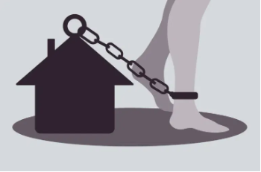
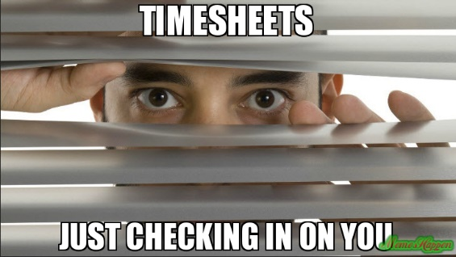
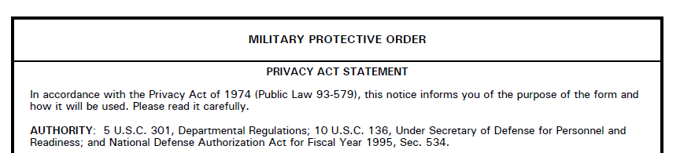
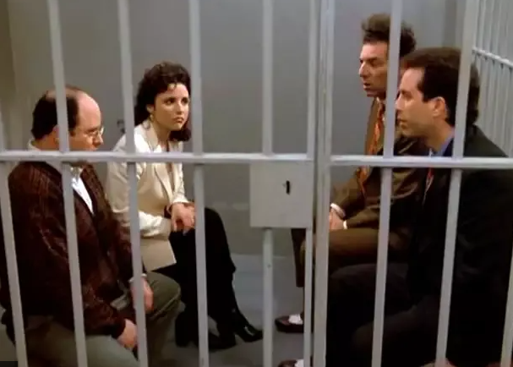

Types of Pretrial Restraint (R.C.M. 304)
(a)(1)Conditions on Liberty
(a)(3)Arrest
(a)(2) Restriction in lieu of arrest
(a)(4) Confinement
-ISH
Notes:
RCM 304(a): PTR is moral or physical restraints on person’s liberty which is imposed before and during disposition of offenses
There are 4 types and note how these ratchet up in intensity as we go
Also recall that CoL do not trigger RCM 707 120-day clock; RILO does trigger 120-day clock; Arrest and PTC trigger both 120-day clock and Article 10 protections
As we’ll see as we go forward, the line between these different measures if very murky and fact-dependent, so TCs have to be very careful in how they advise commanders WRT PTR

Slide 13
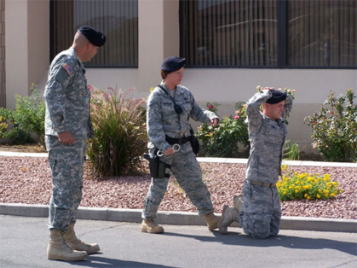
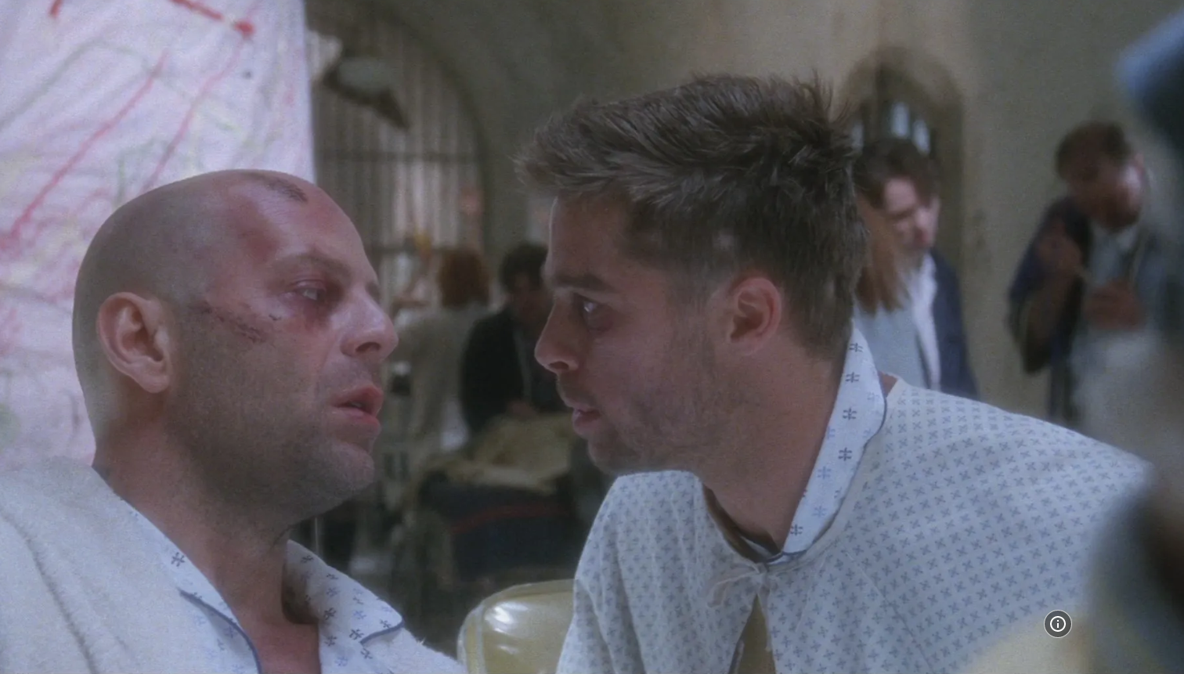
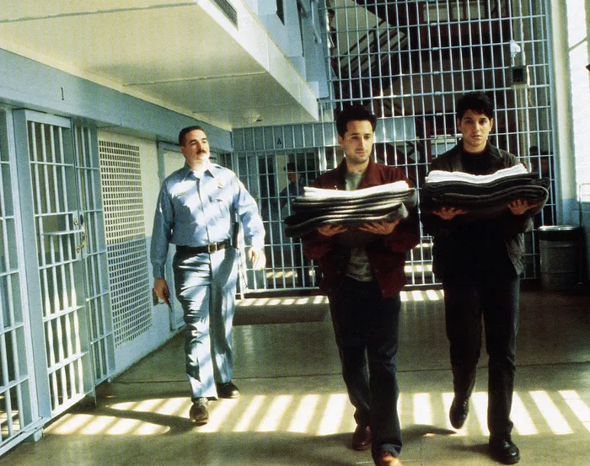
What is NOT Pretrial Restraint?
Apprehension (RCM 302):
Taken into custody by LE based-on PC
Soldier Health/Welfare (RCM 304(h)):
Medical or psychological treatment
Civilian Arrest & Confinement
Notes:
Apprehension: typically done by LEO (MP, CID, etc.)
Can also be done by officers or NCOs. QUESTION: is allowing officers and NCOs to effect apprehension a good idea? NO. It is a horrible idea…things can get out of hand…they are not trained for that…chain of command will get pissed…call the MPs/CID and let them handle it (RCM 302(b)).
PC exists when there are reasonable grounds to believe a person subject to the UCMJ has committed an offense triable by CM (RCM 302(c)); “Reasonable grounds” means that there must be the kind of reliable information that a reasonable, prudent person would rely on which makes it more likely than not that something is true. A mere suspicion is not enough but proof which would support a conviction is not necessary. A person who determines probable cause may rely on the reports of others.
Person remains in custody until command notified and has a chance to take action under RCM 304 or RCM 305 (RCM 302(a) discussion)
CASE DISCUSSION: Coulter Example…Coulter shot his best friend in the face/killed him with a handgun illegally brought onto post after a night of drinking…CID apprehended him and took him to their facility for questioning…turned him over to the command once they arrived so they could handle him (early the next morning…in custody for less than 8 hours after shooting someone in the face)
Soldier health/welfare: SMs facing UCMJ often have tons of other problems, including mental health issues
QUESTION: Why do you think these steps aren’t PTR? Extra measures taken to ensure Soldier health/welfare (command referrals, inpatient care, suicide watch) are done as a function of command and do not constitute pretrial restraint
Administrative restraint (ancillary to the MJ system) do not trigger 120 clock because they are imposed for purposes unrelated to MJ; test is whether the primary purpose in imposing the measures is to restrain the Soldier prior to trial, or for some other purpose
Administrative restraint imposed under R.C.M. 304(h) “for operational or other military purposes independent of military justice, including administrative hold or medical reasons” is not pretrial restraint and does not start the speedy trial clock.
CASE DISCUSSION: After Coulter was released, he was referred to WAMC 6th Floor for behavioral health evaluation…they admitted him for 7 days. After the 7 days, he was released to the custody of the command; command was still heavily concerned because Coulter had shot his best friend, so they placed him under significant control and evaluation (this was close to the line…but better to give some sentence credit than have a SM kill himself…none of this was pretrial restraint)
Most common example of civilian arrest for military offenses is civilian authorities arresting and holding a deserter pending delivery to military forces

Slide 14
Degrees of Pretrial Restraint, R.C.M. 304
No Speedy Trial
Implications
Triggers RCM 707
Speedy Trial
Triggers Article 10 &
RCM 707
Incident
(a)(1)
Conditions on Liberty
(a)(2)
Restriction in Lieu of Arrest
(a)(3)
Arrest
(a)(4) Confinement
Least Severe More Severe Most Severe
Notes:
If you are under conditions on liberty, there are no speedy trial considerations which is different from restriction in lieu of arrest
Date of restriction triggers RCM 707

Slide 15
Conditions on Liberty R.C.M. 304(a)(1)
Written or oral order directing Soldier to do/not do something:
  Report periodically to staff duty/CQ;
  don’t go to certain places;
  don’t contact victims/witnesses, etc.
Cannot interfere with pretrial prep!
Practice Tip: Keep them reasonable!

Slide 16

Conditions on Liberty R.C.M. 304(a)(1)
Soldier is pending trial for alleged drunkenness and assault in violation of Articles 134 and 128.
“You are hereby prohibited from drinking alcohol or attending any bars, clubs or establishments that primarily sell alcohol. Any violation will be punished under the UCMJ.”
Any issues? No, the restrictions seem reasonable to prevent foreseeable future serious misconduct.

Slide 17
Restriction in Lieu of Arrest RCM 304(a)(2)
More severe than conditions of liberty!
“I’m hereby restricting you to the company area of Fort Cavazos. You are only authorized to go to the dining facility, place of worship and medical facilities. You must sign into the CQ every hour on the hour during non-duty hours.”
Still able to perform full military duties
PRACTICE TIP: Remember this type of restraint triggers Speedy Trial

Slide 18
Restriction Factors to Consider
The nature of the restraint (physical or moral);
The area or scope of the restraint (confined to post, barracks, room, etc.);
Types of duties performed during the restraint (routine military duties, fatigue duties, etc.);
The degree of privacy enjoyed within the area of restraint;
Sign in requirements;
Periodic checking of accused and accused quarters by authority;
Notes:
United States v. Delaney, 2017 CCA LEXIS 650 (N.M. Ct. Crim. App. 2017) (holding
Finally, the appellant failed to complain at trial that the conditions of his pretrial restriction were tantamount to confinement. Accordingly, we find his conditions were closer on the spectrum to restriction than confinement. See King, 58 M.J. at 111-12 (holding that restriction to dormitory, dining facility, squadron building, and defense counsel's office; reassignment to cleaning and manual labor duties; requirement to muster twice per day; and inability to use the gym was not tantamount to confinement); United States v. Guerrero, 28 M.J. 223, 224-25 (C.M.A. 1989) (holding that restriction to barracks room, latrine, chapel, mess hall and other places of duty; requirement for an NCO escort; and requirement to muster "every 30 minutes until normal 'lights out" was not tantamount to confinement); Parker, 75 M.J. at 610-11 (holding restriction to base with permission to visit exchange, gym, on-base food establishments, and other base facilities with an escort; requirement to muster every two hours during the day; prohibition against receiving visitors, and reassignment to routine administrative functions was not tantamount to confinement); United States v. Patterson, 201600189, 2017 CCA LEXIS 437 at *23-25 (N-M. Ct. Crim. App. 30 Jun 2017) (holding restriction to barracks room, work area, base chapel, [*13] infirmary, mess hall, 21 Area Exchange, barbershop, dry cleaners, and fitness center; requirement to muster four times per workday and every two hours between 0700 and 1500 then at 1800, 2000, and 2145 on weekends and holidays; requirement of an NCO escort and notification to barracks duty when leaving the barracks; prohibition on the use of alcohol; prohibition on the use of recreational activity centers or participating in intramural sports; prohibition on the operation of a privately owned vehicle; and prohibition against receiving visitors was not tantamount to confinement); Washington v. Greenwald, 20 M.J. 699 (A.C.M.R. 1985) (holding restriction to company area, dining hall, place of duty, and chaplain's office during the day and his room at night; requirement to muster every hour when not at work; and requirement of an escort to travel anywhere after duty hours was not tantamount to confinement).

Slide 19
Restriction Factors to Consider
Under armed or unarmed escort;
Visitation and telephone privileges;
Access to religious, medical, recreational, educational, or other support facilities
Location of the accused's sleeping accommodations;
Access and use of personal property (including civilian clothing).
***A non exhaustive list!

Slide 20
Arrest
Severe restriction + loss of full military duties
  loss of command/authority
Loss of Full Military Duties
Can still do routine training and duties
PRACTICE TIP:
Remember Speedy Trial (R.C.M. 707(a)(2) & Article 10, UCMJ
Notes:
If you confine someone to the barracks room you will trigger both Article 10 and 707

Slide 21
Questions?

Slide 22
Need Training Materials?
Have Training Materials?
Questions?
Contact Us!
TJAGLCS-training@army.mil

